Slide 1

React Native
Tong Zhou

Slide 2
What Is React Native
React Native is a platform for us to build native mobile apps(Android, IOS) using only JavaScript that allows us to use React to build components.
Real Mobile Application: native mobile UI
Notes:
Not mobile web app that render html5 elemnts, can’t distinguish from an app built using Object-C or Java.

Slide 3
Why React Native
Native Experience
One language rules them all
Fast & Great Development Experience
Bridge with Native Code
Goal: Learn once, write anywhere

Slide 4
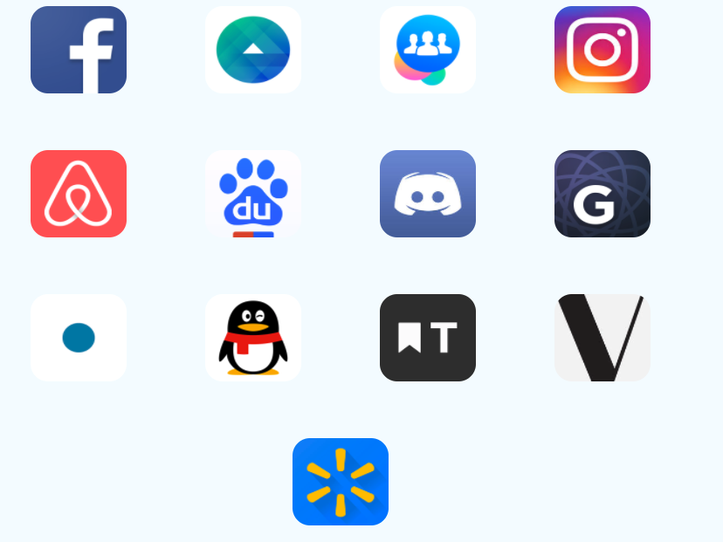
Who’s using React Native

Slide 5
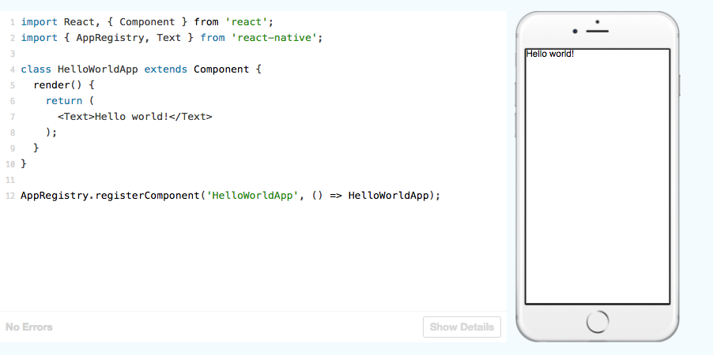
How Does React-Native Work
We know about React
JSX, components, state and props
Notes:
Use JSX to define elements
Treat everything as component
We use state and props to customize components

Slide 6
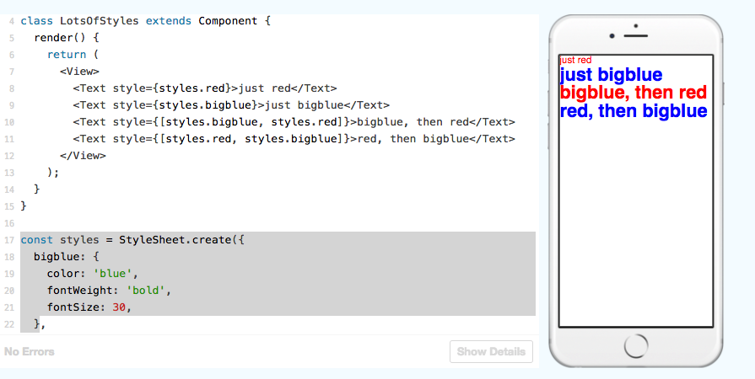
Style
in Web, we have CSS
In React Native, we use Flexbox Layout Model.
Use JS to define a style prop.

Slide 7
Summary
What’s is React
Why React
The basics of React

